Slide 1

BANK LOAN ANALYTICS
Group 1

Slide 2
INTRODUCTION
The bank loan analysis aims to uncover the key factors that influence loan approval and identify trends in loan performance.
By leveraging two comprehensive datasets containing detailed information on borrower demographics, loan characteristics, and credit histories, this analysis seeks to provide insights that can enhance the decision-making process in loan approvals.
The study involves a systematic exploration of variables such as loan amount, interest rates, borrower credit scores, revolve balance and repayment behaviors.
Through rigorous data analysis using tools like SQL, Power BI, Excel, and Tableau, this project aims to highlight patterns that could predict loan outcomes, reduce default risks, and ultimately contribute to a more efficient and secure lending process.
The analysis begins with data extraction and preprocessing using SQL, which allows for efficient handling and querying of large datasets. Excel is then employed for data cleaning, ensuring that the datasets are properly formatted and free from inconsistencies. With the data prepared, Tableau & Power BI are utilized for in-depth data visualization, enabling the creation of interactive dashboards that highlight critical insights and trends.

Slide 3

WHY CHOOSE OUR BANK?
Our bank is committed to providing reliable and customer-centric loan services. With competitive interest rates, transparent terms, and a dedicated support team, we aim to make the loan process as smooth and beneficial as possible for our clients.

Slide 4
DATA OVERVIEW
Our project Bank Analysis consists of two tables, Finance_1 and Finance_2 with 24 columns and 39,717 rows, 25 columns and 39,717 rows respectively.
Finance_1 has the data related to the loan and customer information such as loan id, customer id, loan amount, issue date, interest rate, grade, verification, purpose, zip code, state.
Finance_2 hast the data related to the loan repayment information by the customers such as total amount paid, revolving balance, last payment date, last paid amount.
The common column 'id', which refers to the loan id, uniquely identifies each loan, can be used to combine the two databases.
The following are the primary fields/columns utilised in this analysis:
issue_d: The date a loan is issued is indicated by this term.
loan_amnt: This is the amount that has been granted for a loan.
grade: It speaks of a customer's grade. Based on the credit report, borrowing amount, debt-to-income ratio, and a few other factors, there are seven grades, ranging from A to G.

Slide 5
sub_grade: This term describes the sub-grade that falls inside a given grade. Each grade has five sub-grades, such as A1 through A5.
revol_bal: This stands for revolving balance. It is the amount of money that remains unpaid at the end of each month on a revolving credit loan.
verification_status: This describes the extent to which a customer's details, including income, employment, assets, identity, property value, and so forth, have been validated or not.
total_pymnt: This is the total amount paid back on a loan.
addr_state: This is the name of the state in which a loan is granted.
loan_status: This term describes a loan's state, such as whether it is fully paid, current, or charged off.
home_ownership: This describes whether a consumer owns, rents, or has a mortgage on the house they currently reside in.
last_pymnt_d: This is the date that the last payment for a specific loan was made.

Slide 6
OBJECTIVES
Year wise loan amount.
Grade and Subgrade wise Revolving balance.
Total Payment for Verified vs Total Payment for Non- Verified status.
State wise Month wise loan status.
Home ownership vs Last Payment date status.

Slide 7
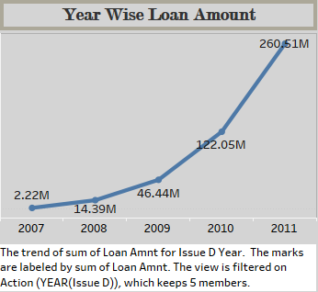
ANALYSIS
•Insight:
•There is a sharp increase in the loan amounts over the years, especially from 2009 onwards, with a peak in 2011 at 261M.
•Recommendation:
•Analyze the factors contributing to the increase in loan amounts, particularly in the years following 2009.
•Ensure that the growth in loan disbursement is sustainable and supported by adequate risk management practices.

Slide 8
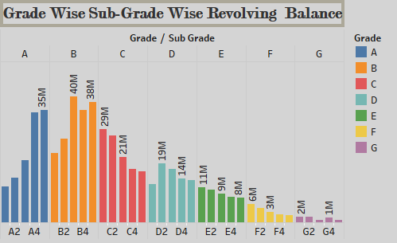
ANALYSIS
•Insight:
•The highest revolving balances are found in sub-grades B3, B5, and B2.
•Sub-grades in category B have significantly higher balances compared to others.
•Recommendation:
•Monitor borrowers in the B grade category closely, especially those in the sub-grades B3, B5, and B2, as they represent higher risk due to larger balances.
•Consider revising lending criteria or offering financial management resources to borrowers in these sub-grades to mitigate risks.

Slide 9
ANALYSIS
•Insight:
•58.88% (220M) of the total payments have been verified, while 41.12% (154M) are not verified.
•Verified payments make up the majority of the total sum.
•Recommendation:
•Focus on the non-verified payments to ensure data integrity and reduce potential risks. Implement verification processes to decrease the percentage of non-verified payments

Slide 10
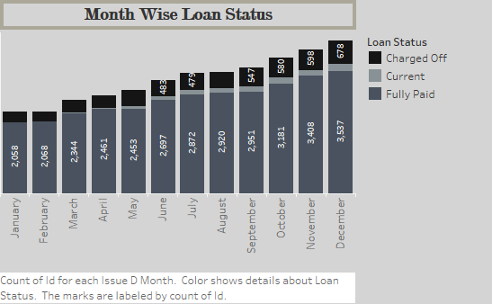
ANALYSIS
•Insights:
•The number of "Fully Paid" loans increases steadily from January to December, with a noticeable spike in the last quarter of the year.
•The "Current" status loans are relatively stable throughout the year, with slight fluctuations.
•"Charged Off" loans show a consistent pattern, remaining significantly lower compared to "Fully Paid" loans, but the number increases gradually towards the end of the year.
•Recommendations:
• "Charged Off" Loans: It might be beneficial to analyze why there is an increase towards the end of the year. Consider improving risk assessment methods during loan approval, especially in the last quarter.
• "Fully Paid" Loans: The upward trend is positive. To maintain or improve this, focus on customer retention strategies and perhaps offer incentives for early repayment.
• "Current" Loans: Since these are stable, focus on maintaining this by ensuring effective communication with borrowers and providing support to prevent them from becoming delinquent.

Slide 11
ANALYSIS
•Insight:
•States like California (CA), New York (NY), and Florida (FL) have the highest counts of fully paid loans.
•The "Charged Off" loans are minimal in comparison across most states, with "Current" loans showing varied trends.
•Recommendation:
•For states with a high number of charged-off loans, consider tightening credit evaluation procedures.
•Focus on states with a large number of current loans to encourage timely payments and reduce the risk of them becoming delinquent.

Slide 12
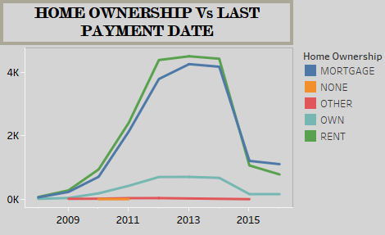
ANALYSIS
•Insights:
•Loans for customers with "Mortgage" and "Rent" status saw a significant increase from 2009, peaking around 2012-2013, and then sharply declining after 2013.
•"OWN" and "OTHER" categories remain relatively stable but are much lower in volume compared to "Mortgage" and "Rent."
•The "NONE" category shows minimal impact , indicating fewer loans in this segment.
•Recommendations:
•For Mortgage and Rent Segments: The sharp decline after 2013 suggests a potential market saturation or economic shift. Reassess the lending criteria and consider targeting customers in the "OWN" category to diversify risk.
•For Stable Segments (OWN, OTHER): These segments have a smaller but consistent number of loans. Explore growth opportunities here by offering specialized loan products or incentives tailored to these groups.
•Economic Factors: Since the data shows a spike and then a drop, external economic factors like interest rate changes, housing market conditions, or policy changes might have influenced these trends. Stay updated on such factors to adapt your strategies.

Slide 13
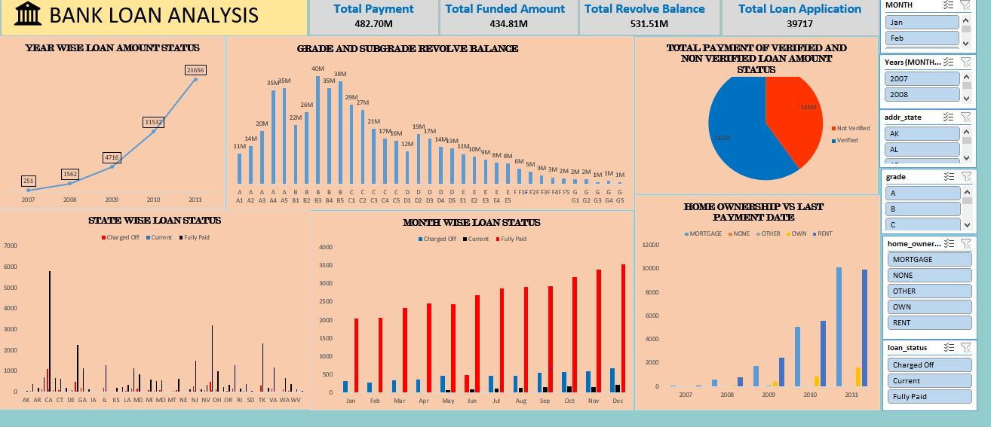
Excel Dashboard

Slide 14
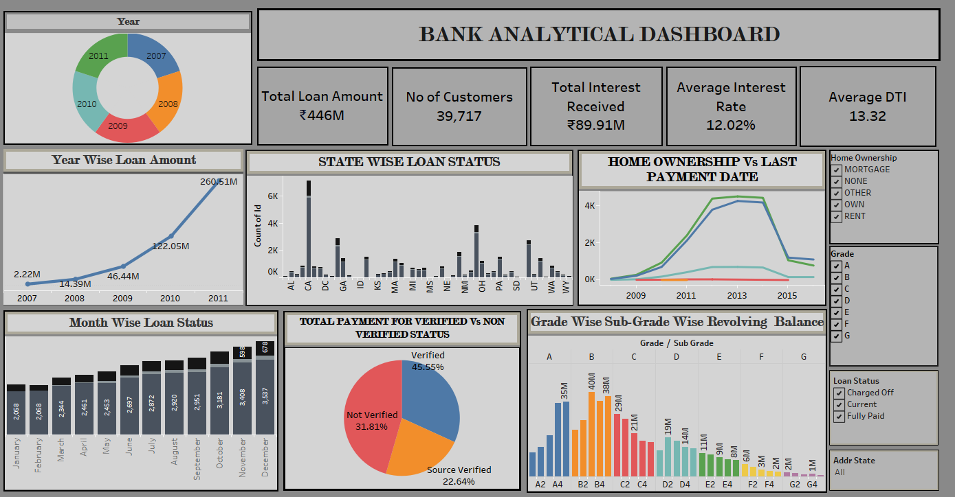
Tableau Dashboard

Slide 15
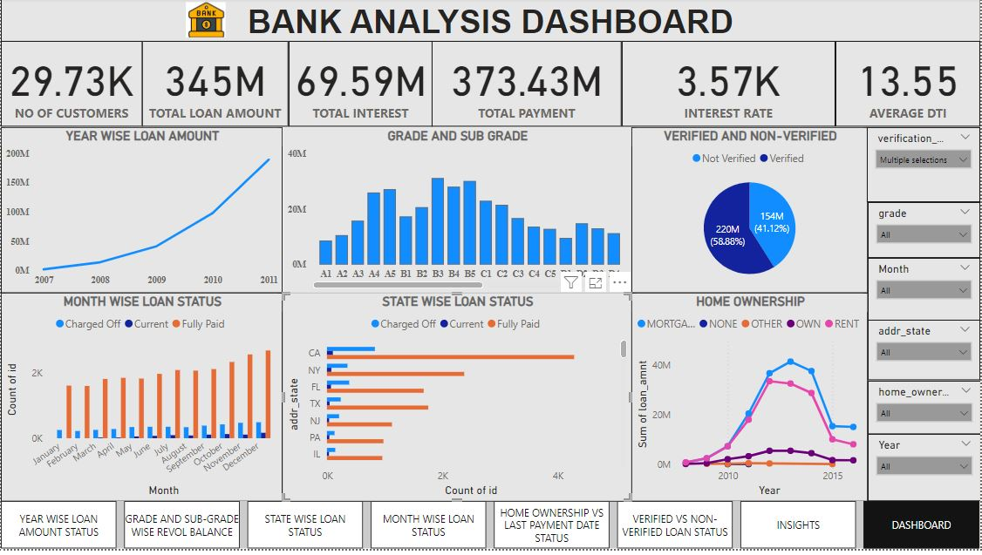
Power BI Dashboard

Slide 16
CONCLUSION
Through the study of data and insightful dashboard it is observed that to maintain a competitive position, the bank needs to work on risk management policies for more stable growth in terms of loan amount.Further the bank needs to revise the lending criteria for efficient results in subgrade loan amount. Also the bank needs to adapt the recent market trends adversely to avoid the economic barriers for instance interest rate(%)and changing government policies in the growth. For more recovery of loan amount according to the loan status the bank should upgrade the credit evaluation process in the respective region and state.

Slide 17


